Slide 1
Tajnička
Michaela Foltínová
8.b

Slide 2
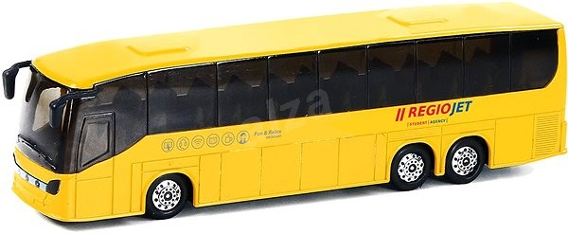
1,
2,
3,
4,
5,
6,
7,
8,
9,
10,
11,
Dopravný prostriedok

Slide 3
1,
2,
3,
4,
5,
6,
7,
8,
9,
10,
11,
A | U | T | O | B | U | S

Slide 4
1,
2,
3,
4,
5,
6,
7,
8,
9,
10,
11,
A | U | T | O | B | U | S
Vodný živočích

Slide 5
1,
2,
3,
4,
5,
6,
7,
8,
9,
10,
11,
A | U | T | O | B | U | S
R | Y | B | A

Slide 6
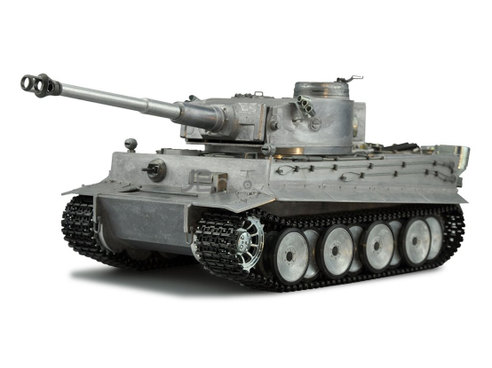
1,
2,
3,
4,
5,
6,
7,
8,
9,
10,
11,
A | U | T | O | B | U | S
R | Y | B | A
Bojové vozidlo

Slide 7
1,
2,
3,
4,
5,
6,
7,
8,
9,
10,
11,
A | U | T | O | B | U | S
R | Y | B | A
T | A | N | K

Slide 8
1,
2,
3,
4,
5,
6,
7,
8,
9,
10,
11,
A | U | T | O | B | U | S
R | Y | B | A
T | A | N | K
Používajú sa na háčkovanie

Slide 9
1,
2,
3,
4,
5,
6,
7,
8,
9,
10,
11,
A | U | T | O | B | U | S
R | Y | B | A
T | A | N | K
I | H | L | I | C | E

Slide 10
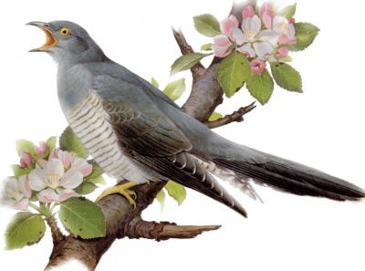
1,
2,
3,
4,
5,
6,
7,
8,
9,
10,
11,
A | U | T | O | B | U | S
R | Y | B | A
T | A | N | K
I | H | L | I | C | E
Vtáčik, ktorý kuká

Slide 11
1,
2,
3,
4,
5,
6,
7,
8,
9,
10,
11,
A | U | T | O | B | U | S
R | Y | B | A
T | A | N | K
I | H | L | I | C | E
K | U | K | U | Č | K | A

Slide 12
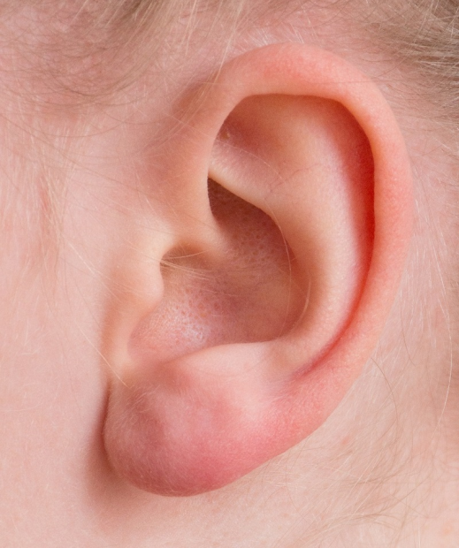
1,
2,
3,
4,
5,
6,
7,
8,
9,
10,
11,
A | U | T | O | B | U | S
R | Y | B | A
T | A | N | K
I | H | L | I | C | E
K | U | K | U | Č | K | A
Orgán cez, ktorý vnímame zvuk

Slide 13
1,
2,
3,
4,
5,
6,
7,
8,
9,
10,
11,
A | U | T | O | B | U | S
R | Y | B | A
T | A | N | K
I | H | L | I | C | E
K | U | K | U | Č | K | A
U | C | H | O

Slide 14
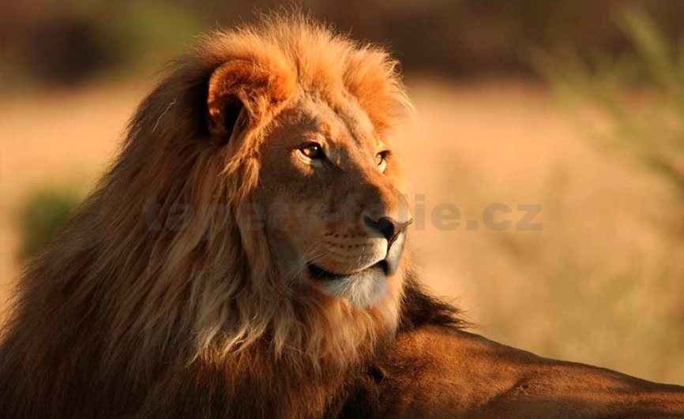
1,
2,
3,
4,
5,
6,
7,
8,
9,
10,
11,
A | U | T | O | B | U | S
R | Y | B | A
T | A | N | K
I | H | L | I | C | E
K | U | K | U | Č | K | A
U | C | H | O
Zviera, ktoré je kráľom džungle

Slide 15
1,
2,
3,
4,
5,
6,
7,
8,
9,
10,
11,
A | U | T | O | B | U | S
R | Y | B | A
T | A | N | K
I | H | L | I | C | E
K | U | K | U | Č | K | A
U | C | H | O
L | E | V

Slide 16
1,
2,
3,
4,
5,
6,
7,
8,
9,
10,
11,
A | U | T | O | B | U | S
R | Y | B | A
T | A | N | K
I | H | L | I | C | E
K | U | K | U | Č | K | A
U | C | H | O
L | E | V
súhlas

Slide 17
1,
2,
3,
4,
5,
6,
7,
8,
9,
10,
11,
A | U | T | O | B | U | S
R | Y | B | A
T | A | N | K
I | H | L | I | C | E
K | U | K | U | Č | K | A
U | C | H | O
L | E | V
Á | N | O

Slide 18
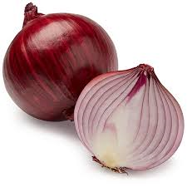
1,
2,
3,
4,
5,
6,
7,
8,
9,
10,
11,
A | U | T | O | B | U | S
R | Y | B | A
T | A | N | K
I | H | L | I | C | E
K | U | K | U | Č | K | A
U | C | H | O
L | E | V
Á | N | O
zelenina

Slide 19
1,
2,
3,
4,
5,
6,
7,
8,
9,
10,
11,
A | U | T | O | B | U | S
R | Y | B | A
T | A | N | K
I | H | L | I | C | E
K | U | K | U | Č | K | A
U | C | H | O
L | E | V
Á | N | O
C | I | B | U | Ľ | A

Slide 20
1,
2,
3,
4,
5,
6,
7,
8,
9,
10,
11,
A | U | T | O | B | U | S
R | Y | B | A
T | A | N | K
I | H | L | I | C | E
K | U | K | U | Č | K | A
U | C | H | O
L | E | V
Á | N | O
C | I | B | U | Ľ | A
Používa sa na šitie

Slide 21
1,
2,
3,
4,
5,
6,
7,
8,
9,
10,
11,
A | U | T | O | B | U | S
R | Y | B | A
T | A | N | K
I | H | L | I | C | E
K | U | K | U | Č | K | A
U | C | H | O
L | E | V
Á | N | O
C | I | B | U | Ľ | A
I | H | L | A

Slide 22
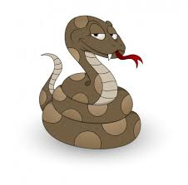
1,
2,
3,
4,
5,
6,
7,
8,
9,
10,
11,
A | U | T | O | B | U | S
R | Y | B | A
T | A | N | K
I | H | L | I | C | E
K | U | K | U | Č | K | A
U | C | H | O
L | E | V
Á | N | O
C | I | B | U | Ľ | A
I | H | L | A
Veľký had

Slide 23
1,
2,
3,
4,
5,
6,
7,
8,
9,
10,
11,
A | U | T | O | B | U | S
R | Y | B | A
T | A | N | K
I | H | L | I | C | E
K | U | K | U | Č | K | A
U | C | H | O
L | E | V
Á | N | O
C | I | B | U | Ľ | A
I | H | L | A
A | N | A | K | O | N | D | A

