Slide 1
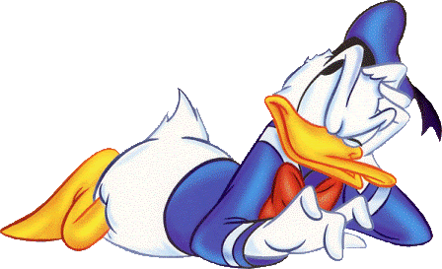
Počítame do 100
s káčerom Donaldom
Mgr. Oľga Oslanecová

Slide 2
Najprv vypočítaj
príklad, až potom klikni a over si
správny výsledok .

Slide 3
Ak správne vypočítaš
všetky príklady
na stránke, objaví sa ti tlieskajúci smajlík
zvuk zvončeka .

Slide 4
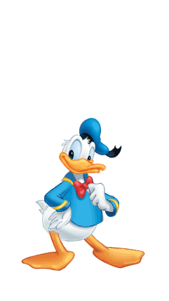
76 + 10 - 5 =
81
29 - 4 + 20 =
45
62 + 3 - 30 =
35
57 - 2 - 20 =
35
6 + 23 - 7 =
22

Slide 5
92 + 4 - 20 =
76
9 + 40 - 7 =
42
4 + 53 - 10 =
47
67 - 30 - 3 =
34
67
80 - 20 + 7 =

Slide 6
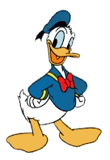
7 + 40 - 20 =
27
90 - 50 + 3 =
43
50 + 9 - 10 =
49
67 - 20 - 5 =
42
85 - 60 + 2 =
27

Slide 7
62 + 4 - 30 =
36
57 - 7 + 30 =
80
8 + 32 - 10 =
30
7 + 3 + 50 =
60
86 - 40 - 4 =
42

Slide 8
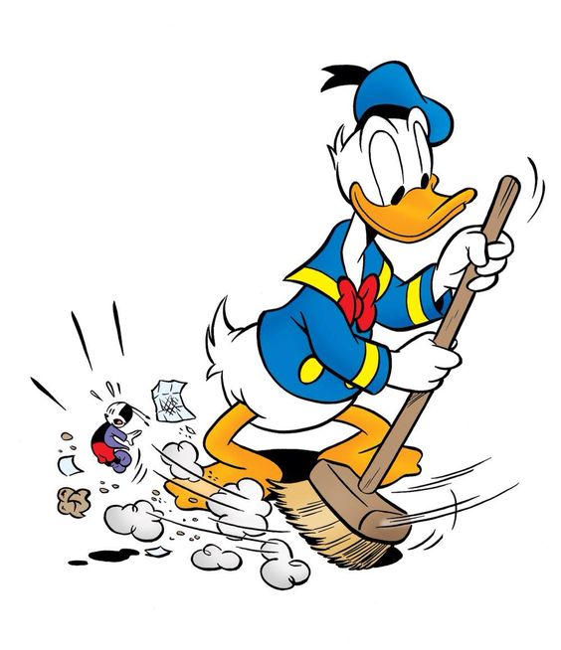
2 + 40 - 20 =
22
36 + 40 - 6 =
70
7 + 62 - 10 =
59
93 - 50 - 3 =
40
29 + 60 - 7 =
82

Slide 9
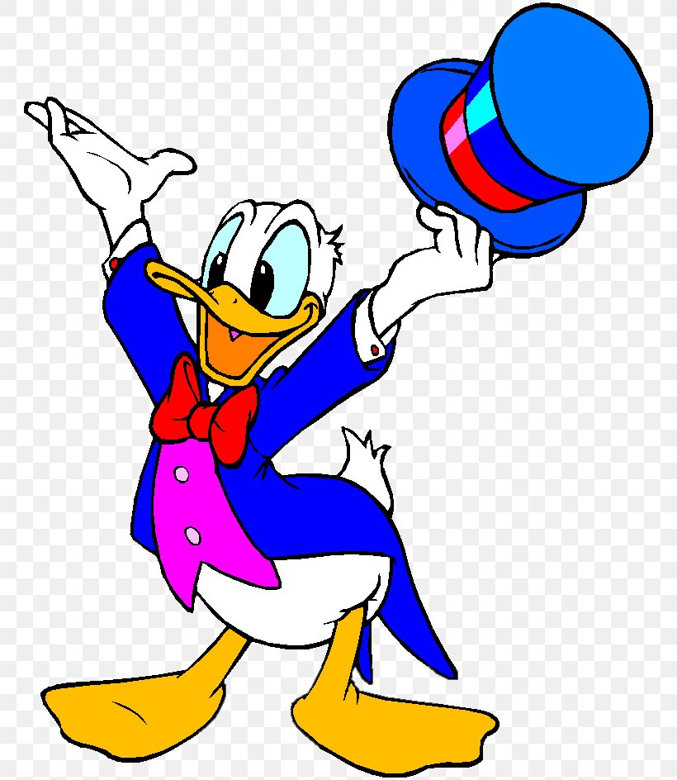
12 + 25 - 7 =
30
5 + 50 - 30 =
25
34 + 5 - 7 =
32
87 - 20 - 4 =
63
22 + 64 - 6 =
80

Slide 10
78 - 2 - 20 =
56
3 + 60 - 10 =
53
41 + 5 - 20 =
26
6 + 52 - 4 =
54
57 - 30 - 6 =
21

Slide 12
Ste šikovné deti

Slide 13
Vypočítaj: Meno: .............................................
17 + 2 = __
25 + 4 = __
98 – 5 = __
76 – 3 = __
54 – 2 = __
65 + 3 = __
10 + 70 = __
80 – 60 = __
2 + 65 = __
4 + 44 = __
66 – 3 = __
48 – 7 = __
32 + 5 = __
95 + 1 = __
63 – 2 = __
60 – 40 = __
4 + 32 = __
57 – 4 = __
88 – 2 = __
2 + 56 = __
70 + 6 = __
87 – 4 = __
59 – 3 = __
5 + 34 = __
12 + 20 + 3 = __
58 + 1 – 4 = __
36 – 4 + 7 = __
63 – 3 + 5 = __
89 – 6 + 4 = __
60 – 40 + 7 = __
80 – 20 – 50 = __
45 – 5 + 9 = __
4 + 24 + 1 = __
76 – 4 + 5 = __
8 + 30 – 5 = __
6 + 50 – 2 = __

Slide 14
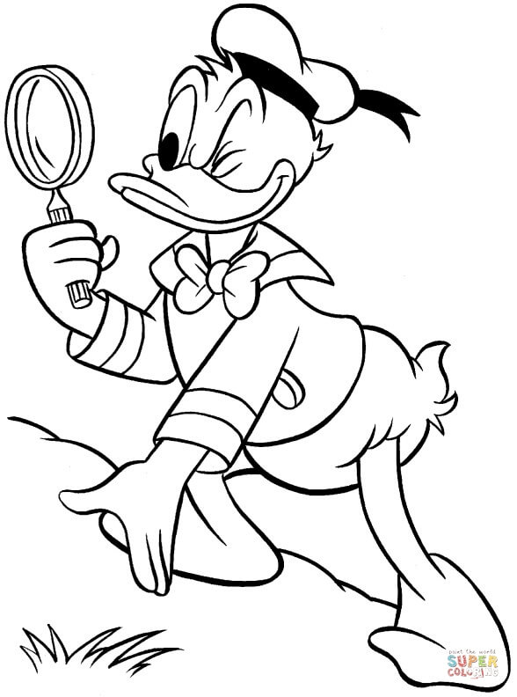

Slide 16
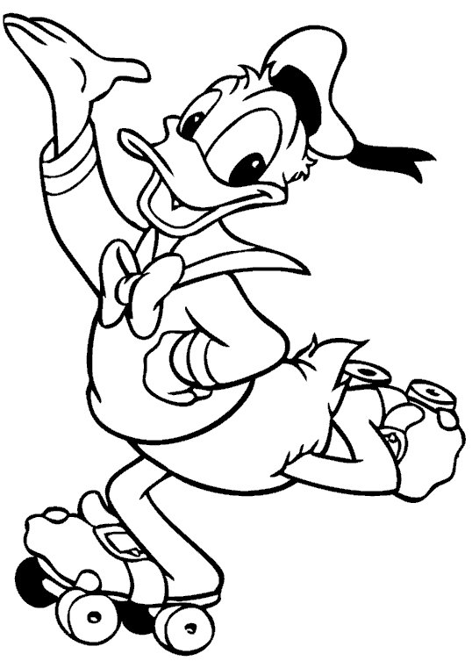

Slide 18
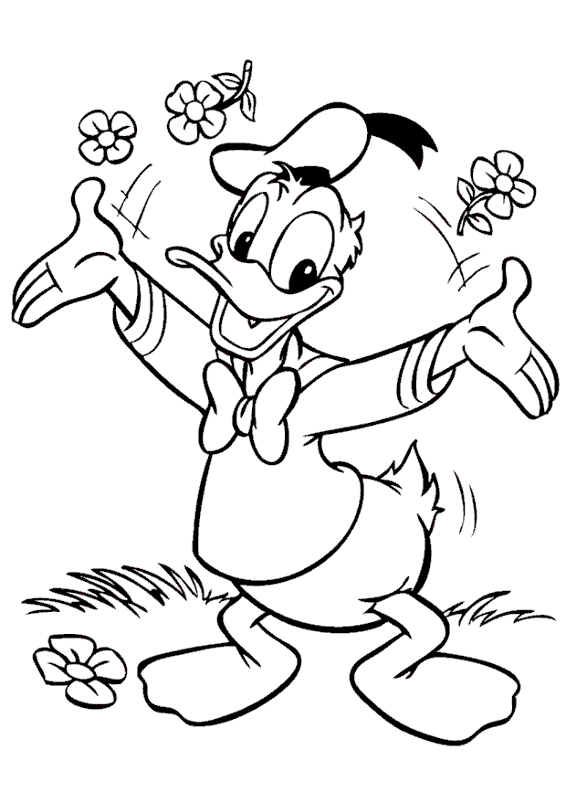

Slide 20
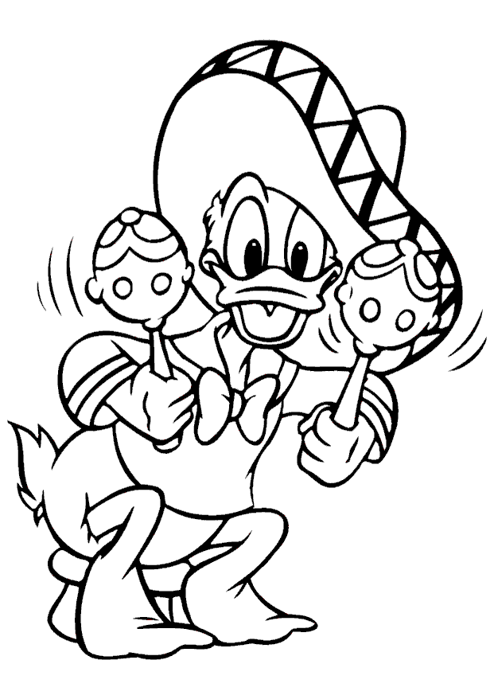

Slide 22
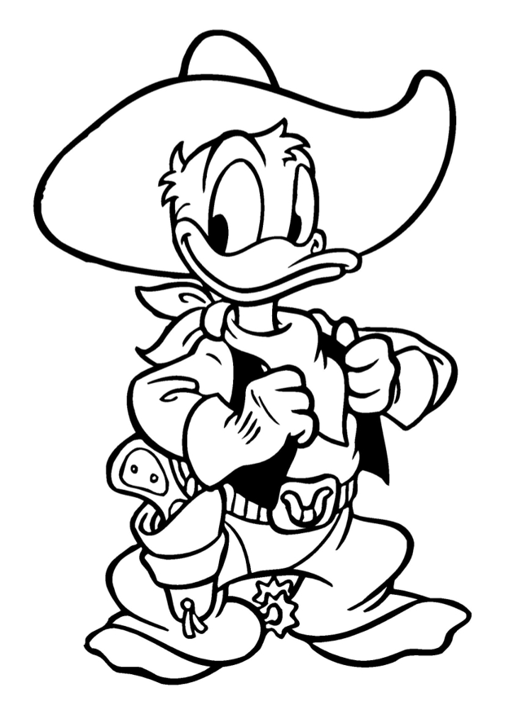

Slide 24
